Slide 1
Fundamentals of Fog and Edge Computing
BCSE313L
WINTER 2024 - 2025
Module 6 - Technologies in Fog Computing

Slide 2
Fog Data Management
It focuses on handling the entire data life cycle efficiently while addressing the unique characteristics of IoT data.

Slide 3
Fog Data Management - Fog Data Life Cycle
Data Acquisition
Lightweight Processing
Processing and Analysis
Sending Feedback
Command Execution

Slide 4
Fog Data Management - Fog Data Life Cycle
Data Acquisition
Data is collected from end devices (e.g., sensors, actuators).
Data can be sent directly to the fog or via a sink node/local gateway.
Lightweight Processing
Involves lightweight data manipulation such as aggregation, filtering, cleaning, compression /decompression, and pattern extraction.
Provides pre-processing feasibility by leveraging locally stored data in fog devices.
Feedback data may require decompression, decryption, or format changes before being sent back to the device layer.

Slide 5
Fog Data Management - Fog Data Life Cycle
Processing and Analysis
Data is permanently stored in the cloud layer for deeper analysis.
Big data platforms (e.g., HDFS, MapReduce) are used for large-scale processing and analytics.
Users can access reports or insights derived from stored data.
Sending Feedback
Commands or decisions are generated based on processed data and sent to the fog layer.
Command Execution
Actuators execute actions based on feedback received from the fog/cloud layers.

Slide 6
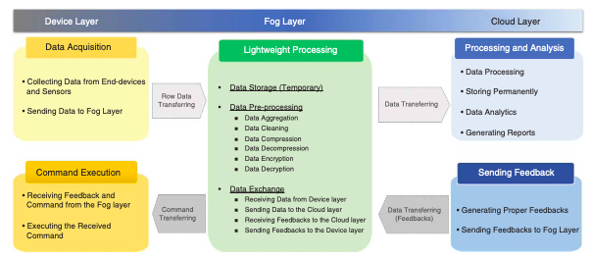
Fog Data Management – IoT Data Characteristics

Slide 7
Fog Data Management – IoT Data Characteristics
Heterogeneity
End devices generate data in diverse formats and structures.
Requires standardization and semantic processing for integration.
Inaccuracy
Sensor data may have uncertainties due to precision errors or misreading.
Affects data reliability and decision-making.
Weak Semantics
Raw data often lacks meaningful context or structure.
Semantic web technologies can enhance interpretability by enriching raw data with metadata.

Slide 8
Fog Data Management – IoT Data Characteristics
Velocity
High data generation rates and varying sampling frequencies challenge real-time processing capabilities.
Redundancy
Repetitive data from multiple devices increases storage and processing overhead.
Scalability
Large numbers of devices and high sampling rates lead to massive data volumes, requiring scalable solutions.
Inconsistency
Low precision or misreading in sensor data causes inconsistencies in the dataset.

Slide 9
Fog Data Management – Data Preprocessing
Data pre-processing is a critical step in fog data management to ensure data quality and usability for analytics and decision-making.
Data Cleaning
Purpose : To address "dirty data" issues such as missed or unreliable sensor readings.
Approaches :
Declarative Data Cleaning
Uses high-level declarative queries (e.g., Continuous Query Language, CQL) to define constraints on sensor values.
Example: Extensible Sensor Stream Processing (ESP), a declarative-based framework for pervasive applications.
Model-Based Data Cleaning
Detects anomalies by comparing raw sensor values with inferred values derived from models.
Subcategories include:
Regression Models : Polynomial regression, Chebyshev regression.
Probabilistic Models : Kalman filter.
Outlier Detection Models : Techniques to identify inconsistent or abnormal data points.

Slide 10
Fog Data Management – Data Fusion
Purpose : Eliminates redundancy, ambiguity, and inconsistencies while integrating data from multiple sources.
Categories :
Data-Based Model : Focuses on imperfections like impreciseness, incompleteness, vagueness, or uncertainty.
Activity-Based Model : Deals with dependency among data.
Role-Based Model : Addresses conflicts and diversity in data.
Frameworks :
Imperfect, correlated, inconsistent, and disparate data fusion frameworks.
Examples: Intelligent Cycle (IC), Joint Directors of Laboratories (JDL).

Slide 11
Fog Data Management – Edge Mining
Purpose : Reduces data volume through local analytics and stream processing at the edge (fog layer).
Definition : Processes sensory data near or at the point of sensing to convert raw signals into contextually relevant information.
Techniques :
Linear Spanish Inquisition Protocol (L-SIP) : A lightweight algorithm for local data compression, reducing data size via state estimation.
ClassAct and Bare Necessities (BN) : Algorithms that achieve significant reductions in packet transmission (99.6% and 99.98%, respectively).
Collaborative Edge Mining : Extends edge mining to further reduce transferred data size.

Slide 12
Fog Data Management – Data Privacy
Privacy preservation is a key functionality in fog computing to protect sensitive data from unauthorized access. Key aspects include:
Authentication Challenges :
Mobility and dynamic network nature (e.g., smart transportation) require adaptive authentication mechanisms.
Location Privacy :
Sensitive location data must be protected to prevent misuse.
Secure positioning protocols ensure correctness, positioning security, and location privacy.
Privacy-Preserving Data Aggregation :
Techniques such as Chinese Remainder Theorem, one-way hash, and homomorphic Paillier encryption enable fault-tolerant aggregation, authentication, and detection of false data injection in the fog layer.

Slide 13
Fog Data Management – Data Storage and Management
Efficient data storage and placement are essential for minimizing latency and optimizing resource usage in fog computing environments.
Storage Policies :
Data may be discarded after pre-processing or temporarily stored in fog devices for further processing or aggregation.
Constraints include storage capacity, memory limitations, and the need for low-latency cache management.
Decision Factors :
Duration and volume of stored data depend on application type and infrastructure capabilities.

Slide 14
Fog Data Management – Data Storage and Management
Placement Strategies :
Efficient placement of data in fog storages considers node characteristics, geographical zones, and application types.
iFogStore :
Proposed by Naas et al., it reduces latency by considering fog device heterogeneity, location, and capacity constraints.
Supports dynamic data consumer locations and efficient data sharing.

Slide 15
Fog Data Management – Architecture
Data Management Architecture :
A three-layer architecture was proposed in [30] for real-time decision-making:
Edge (Fog) Layer : Includes six components—monitoring, data preparation, adaptive algorithm, specification list, storage, and mediator component—for storage-constrained systems.
Cloud Layer : Stores historical data.
Gathering Layer (Device Layer) : Generates raw data.

Slide 16
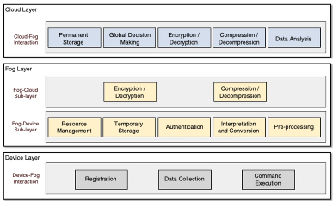
Fog Data Management – Architecture
Data Management Architecture

Slide 17
Fog Data Management – Architecture
Data Management Architecture
Device Layer Modules:
Registration Module: Allows devices to dynamically join or leave the network, receiving a unique ID and key for authentication.
Data Collection/Command Execution Module: Collects data from sensors and executes commands received from the fog layer.

Slide 18
Fog Data Management – Architecture
Data Management Architecture
Fog Layer Modules:
Resource Management: Manages device registrations and deactivates inactive devices based on policy.
Temporary Storage: Stores incoming data and device specifications for authentication.
Pre-Processing: Prepares, aggregates, and processes data for analysis, including data cleaning and filtering.
Encryption/Decryption and Compression/Decompression: Enhances data privacy and reduces network overhead.

Slide 19
Fog Data Management – Architecture
Data Management Architecture
Fog Layer Functions:
Acts as an intermediate layer for data processing and analysis, reducing latency by processing data closer to the source.
Supports heterogeneous communication protocols for device interaction.

Slide 20
Fog Data Management – Architecture
Data Management Architecture
Cloud Layer Modules:
Permanent Storage: Stores large volumes of data from fog zones, utilizing big data technologies.
Global Decision-Making: Processes data to provide feedback to lower layers and stores useful data.
Data Analysis: Performs pattern recognition and knowledge discovery from heterogeneous data.

Slide 21
Fog Data Management – Architecture
Data Management Architecture
Security and Efficiency:
Both fog and cloud layers implement encryption and compression to protect data privacy and reduce network overhead.
Fog computing enhances security by providing additional measures such as authentication and encryption at the edge.

Slide 22
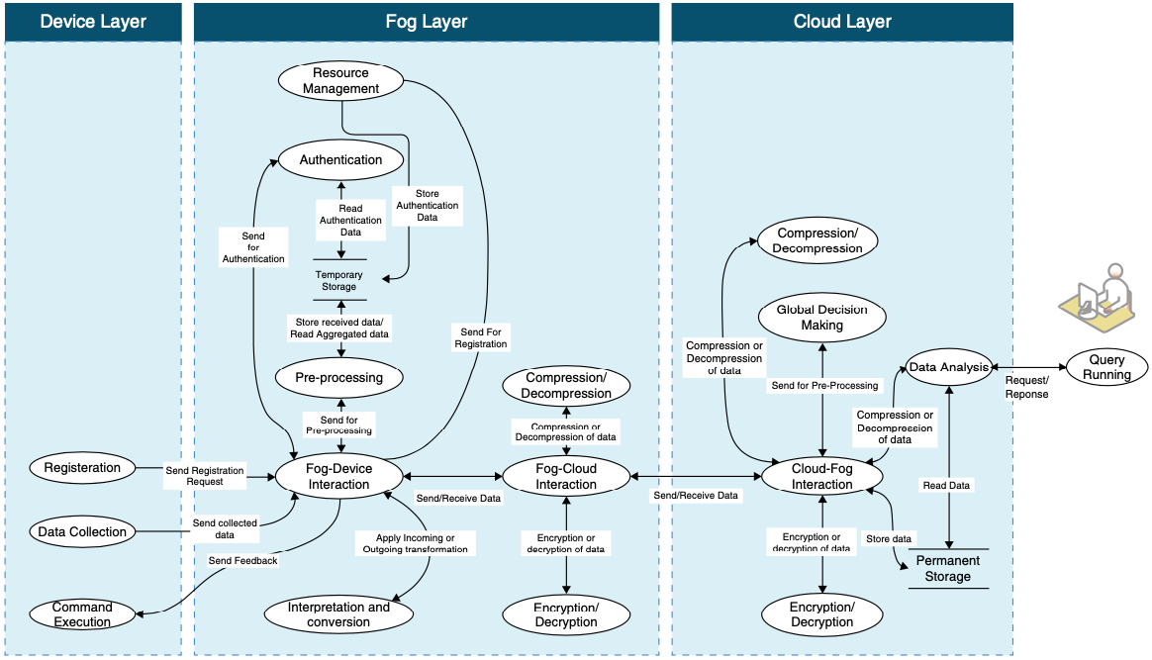
Fog Data Management – Architecture Interaction

Slide 23
Fog Data Management – Case Study - eHealth
Fog computing is critical for managing large volumes of data generated by e-Health devices (e.g., ECG devices that produce several GBs of data daily).
It helps reduce network bandwidth, storage, and processing overhead by handling data locally at the edge (fog layer) rather than sending all data directly to the cloud.

Slide 24
Fog Data Management – Case Study - eHealth
e-Health systems monitor patients' health parameters (e.g., blood glucose, blood pressure, heartbeat, motion, location) using sensors that transmit data to a local gateway (fog device) at short intervals (e.g., every minute).
The fog layer performs pre-processing to detect emergency conditions (e.g., blood glucose > 400 mg/dl or blood pressure > 140/90 mmHg).
In emergencies, immediate actions are taken through fog devices, such as triggering an insulin injection via a bracelet or notifying emergency services.

Slide 25
Fog Data Management – Case Study - eHealth
e-Health applications provide 24/7 monitoring and control of patients at a lower cost compared to traditional nursing care.
They offer benefits like ease of use, cost reduction, increased availability, and better services .

Slide 26
Fog Data Management – Case Study - eHealth
Before sending data to the cloud, the fog layer applies data compression (to reduce size) and encryption (to ensure privacy).
Preliminary data aggregation, manipulation, and processing occur in the fog layer, ensuring only relevant or processed data is sent to the cloud.

Slide 27
Fog Data Management – Case Study - eHealth
After initial processing in the fog layer, data is sent to the cloud layer at predefined intervals or based on specific events.
The cloud stores and processes the data for long-term analysis, enabling users (e.g., doctors, patients) to access health reports and insights.

Slide 28
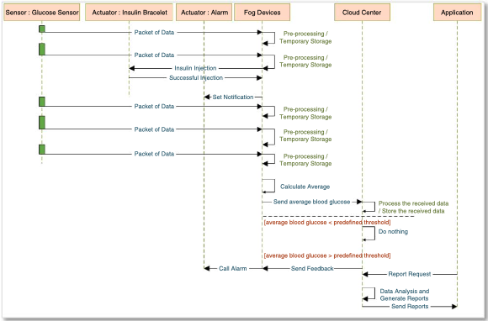
Fog Data Management – Case Study - eHealth

Slide 29
Predictive Analysis with FogTorch𝚷
FogTorchΠ is an open-source Java prototype designed to determine eligible deployments for multi-component applications on fog infrastructures.
It considers QoS (Quality of Service) , context , and cost-awareness during deployment decisions.

Slide 30
Predictive Analysis with FogTorch𝚷 - Inputs
Infrastructure (I)
Describes the available infrastructure for application deployment
Includes IoT devices , fog nodes , and cloud data centers with their hardware/software capabilities.
Specifies probability distributions of QoS metrics like latency and bandwidth for communication links:
Cloud-to-fog
Fog-to-fog
Fog-to-things
Includes costs for:
Purchasing sensed data from IoT devices.
Using virtual instances in cloud/fog environments.

Slide 31
Predictive Analysis with FogTorch𝚷 - Inputs
Multicomponent Application (A):
Specifies the requirements of each application component:
Hardware needs : CPU, RAM, storage.
Software needs : Operating systems, libraries, frameworks.
IoT requirements : Types of IoT devices/things needed.
QoS needs : Latency and bandwidth required for interactions between:
Component-to-component.
Component-to-IoT devices.

Slide 32
Predictive Analysis with FogTorch𝚷 - Inputs
Things Binding (𝝑):
Maps each IoT requirement of an application component to an actual IoT device/thing available in the infrastructure (I ).
Deployment Policy (𝜹):
Defines constraints on where application components can be deployed:
Based on security or business-related rules .
Whitelists eligible nodes (e.g., specific fog nodes or cloud data centers).

Slide 33
Predictive Analysis with FogTorch𝚷 - Workflow
Input: the inputs (Infrastructure, Application, Things Binding, Deployment Policy) are provided to the tool.
Output: FogTorchΠ generates eligible deployments that satisfy all constraints and requirements.

Slide 34
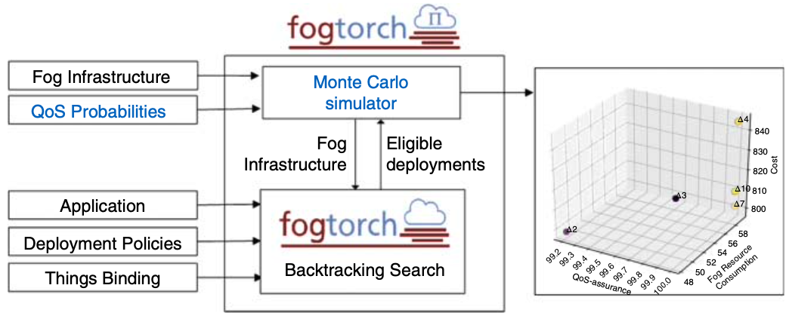
Predictive Analysis with FogTorch𝚷 - Workflow

Slide 35
FogTorch𝚷 – What it does?
FogTorchΠ is a tool that helps figure out the best way to deploy (place) the parts of an application onto cloud or fog nodes.
It ensures that all requirements are met, such as hardware, software, network speed (latency), and bandwidth.

Slide 36
FogTorch𝚷 – How Does it Find Eligible Deployments?
Eligibility Rules for Deployment:
Each part (component) of the application must be placed on a cloud or fog node that:
Follows the deployment rules (e.g., security or business constraints).
Meets the hardware and software needs of the component.
Can connect to all required IoT devices (directly or through a network link).
Has enough resources (like CPU, memory) to handle all components placed on it.
Ensures the required speed (latency) and data transfer rate (bandwidth) for communication between components and IoT devices.

Slide 37
FogTorch𝚷 – How Does it Find Eligible Deployments?
Step 1: Preprocessing
Before searching for deployments, FogTorchΠ checks which cloud or fog nodes can host each component based on:
Deployment rules.
Hardware/software needs.
Latency requirements for connecting to IoT devices.
If no suitable node is found for even one component, the process stops immediately because there’s no valid deployment.

Slide 38
FogTorch𝚷 – How Does it Find Eligible Deployments?
Step 2: Backtracking Search
FogTorchΠ uses a method called backtracking search to explore all possible ways to deploy the components.
Imagine a tree where:
Each level represents deploying one component.
The root (top) is an empty deployment (nothing deployed yet).
Leaves (bottom) represent complete deployments where all components are placed.
Each branch explores placing a component on a specific node.

Slide 39
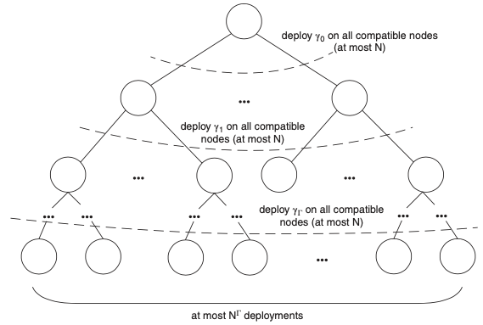
FogTorch𝚷 – How Does it Find Eligible Deployments?

Slide 40
FogTorch𝚷 – How Does it Find Eligible Deployments?
Start with an Empty Deployment
Try Placing Components One by One
Check if the Placement is Valid
If Valid, Continue
If Not Valid, Undo and Try Another Node.
Finish When All Components Are Placed

Slide 41
FogTorch𝚷 – How Does it Find Eligible Deployments?
Start with an Empty Deployment:
Begin with no components deployed.
Try Placing Components One by One:
Pick a component that hasn’t been deployed yet.
Try placing it on a suitable node (from the preprocessed list).
Check if the Placement is Valid:
Ensure the node has enough resources (CPU, memory, bandwidth).
Check if the placement meets latency and bandwidth requirements.
If Valid, Continue:
Update the available resources on the node (subtract what the component uses).
Move to the next component and repeat.
If Not Valid, Undo and Try Another Node:
If the placement doesn’t work, "undo" it (release resources) and try another node.
Finish When All Components Are Placed:
Once all components are successfully placed, save the deployment as a valid option.

Slide 42
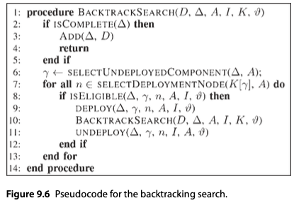
FogTorch𝚷 – How Does it Find Eligible Deployments?

Slide 43
FogTorch𝚷 – How Does it Find Eligible Deployments?
Why Is This Efficient?
Preprocessing Saves Time: By filtering out unsuitable nodes early, FogTorchΠ avoids wasting time on bad options.
Backtracking Explores Options Systematically: It tries all possibilities but backtracks (undoes) when something doesn’t work, ensuring no valid deployment is missed.

Slide 44
FogTorch𝚷 – How Does it Find Eligible Deployments?
Time Complexity
Preprocessing: Takes time proportional to the number of nodes (O(N)).
Search: Takes time proportional to the number of nodes raised to the power of the number of components (O(N^{Γ})), where:
N = Number of cloud/fog nodes.
Γ = Number of components in the application.

Slide 45
FogTorch𝚷 – How Does it Estimates?
how FogTorchΠ estimates:
Resource consumption on fog nodes.
Monthly costs for deploying an application across cloud and fog infrastructure.

Slide 46

FogTorch𝚷 – Estimating Fog Resource Consumption
What is Measured?
The tool calculates the aggregated average percentage of consumed resources (RAM and storage) across all fog nodes hosting the application.
How is it Calculated?
For each component of the application:
RAM(γ) : RAM required by the component.
HDD(γ) : Storage required by the component.
RAM(f) : Total RAM available at the node.
HDD(f) : Total storage available at the node.

Slide 47
FogTorch𝚷 – Estimating Monthly Costs
The cost estimation considers three main categories: hardware , software , and IoT (thing) costs.
Hardware Costs
Two types of hardware offerings are considered:
Default VMs : Predefined configurations with fixed monthly fees.
On-demand VMs : Customizable configurations priced based on individual resources (CPU, RAM, HDD).

Slide 48

FogTorch𝚷 – Estimating Monthly Costs
Cost Calculation
If using a default VM:
Cost = Fixed monthly fee for the VM.
If using an on-demand VM
Cost = Sum of (resource amount × unit cost of the resource) for CPU, RAM, and HDD.

Slide 49
FogTorch𝚷 – Estimating Monthly Costs
Software Costs
Two types of software offerings are considered:
Predefined Bundles : Fixed monthly fees for a set of software features.
On-demand Software : Individual software components sold separately.

Slide 50

FogTorch𝚷 – Estimating Monthly Costs
Cost Calculation
If using a bundle:
Cost = Fixed monthly fee for the bundle.
If using on-demand software:
Cost = Sum of (monthly cost of each software component).

Slide 51
FogTorch𝚷 – Estimating Monthly Costs
IoT (Thing) Costs
Two pricing models are considered:
Subscription-based : Fixed monthly fee for unlimited access to the IoT device.
Pay-per-invocation : Charged per use of the device (including data transfer costs).

Slide 52

FogTorch𝚷 – Estimating Monthly Costs
Cost Calculation
If subscription-based:
Cost = Monthly subscription fee.
If pay-per-invocation:
Cost = Number of expected invocations × Cost per invocation.

Slide 53

FogTorch𝚷 – Combining Costs for Deployment
The total monthly cost of a deployment is calculated by summing up:
Hardware costs for all components.
Software costs for all components.
IoT costs for all required devices.
Total Cost = Sum of (Hardware Cost + Software Cost + IoT Cost) for all components.

Slide 54
FogTorch𝚷 – Problem with Initial Cost Estimation
The initial cost model always prefers on-demand VMs and pay-per-invocation IoT if exact matches for requirements aren’t available.
This can lead to overestimating costs , as cheaper options (e.g., smaller VMs or subscription-based IoT) might satisfy the requirements.

Slide 55
FogTorch𝚷 – Refined Cost Model
To address overestimation, FogTorchΠ introduces a best-fit lowest-cost policy :
Hardware : Chooses the cheapest option between:
Default VMs (e.g., tiny, small, medium).
On-demand VMs built to match the exact requirements.
Software : Selects the cheapest compatible version of the required software.
IoT : Compares subscription-based vs. pay-per-invocation costs and picks the cheaper option.

Slide 56
FogTorch𝚷 – Refined Cost Model
Hardware
pm(Hardware, Node) = Minimum cost of (default VMs or on-demand VMs) that meet requirements.
Software
pm(Software, Node) = Minimum cost of (bundles or on-demand software) that meet requirements.
IoT
pm(Thing, Device) = Minimum cost of (subscription or pay-per-invocation) that meets requirements.

Slide 57
FogTorch𝚷 – Key Benefits Cost Model
Separates VM and Software Costs: Allows flexibility for both IaaS (Infrastructure as a Service) and PaaS (Platform as a Service) offerings.
Extensible: Can include other types of virtual instances (e.g., containers) beyond VMs.
Cost-Aware Matching: Ensures the cheapest suitable options are chosen for hardware, software, and IoT.

Slide 58
FogTorch𝚷 – Example
Suppose a component requires:
Hardware : 1 CPU, 1GB RAM, 20GB HDD.
Available options at Cloud 2:
Default VM: Small instance (€25).
On-demand VM: Custom configuration (€30).
FogTorchΠ selects the small instance (€25) because it satisfies the requirements at a lower cost.

Slide 59
FogTorch𝚷 – QoS Assurance
In addition to estimating resource consumption and cost , FogTorchΠ calculates the QoS-assurance of eligible deployments.
QoS-assurance measures how likely a deployment is to meet all desired Quality of Service (QoS) constraints (e.g., latency, bandwidth) under varying network conditions.

Slide 60
FogTorch𝚷 – QoS Assurance – How is it Estimated?
FogTorchΠ uses:
To find eligible deployments that satisfy QoS requirements.
Parallel Monte Carlo Simulations : To simulate variations in network conditions and assess the robustness of deployments.

Slide 61
FogTorch𝚷 – QoS Assurance – Step by Step Process
Step 1: Initialize a Dictionary
An empty thread-safe dictionary D is created to store:
Key (Δ) : Represents an eligible deployment.
Value (counter) : Tracks how many times the deployment Δ is generated during the simulation.
Step 2: Divide Simulation Runs Among Threads
The total number of Monte Carlo runs (n ) is divided among available worker threads (w ).
Each thread performs nw = ⌈n / w⌉ runs in parallel.
Each thread works on its own local copy of the infrastructure (I ).

Slide 62
FogTorch𝚷 – QoS Assurance – Step by Step Process
Step 3: Simulate Network Conditions
At the start of each run:
Each worker thread samples a state (Is ) of the infrastructure based on the probability distributions of QoS metrics (e.g., latency, bandwidth) for communication links.
A sampling function is used to generate random QoS values for links, but FogTorchΠ supports arbitrary probability distributions.
Step 4: Find Eligible Deployments
The function FindDeployments(A, Is, θ, δ) is called:
It performs an exhaustive backtracking search to find all eligible deployments (E ) for the application (A ) under the sampled infrastructure state (Is ).
Eligible deployments must satisfy:
Processing requirements (hardware/software).
QoS requirements (latency, bandwidth).

Slide 63
FogTorch𝚷 – QoS Assurance – Step by Step Process
Step 5: Update Deployment Counts
After each run:
The set of eligible deployments (E ) is merged into the dictionary D using the function UnionUpdate(D, E) :
If a deployment (Δ ) is new (not already in D ), it is added with a counter of 1.
If a deployment (Δ ) already exists in D , its counter is incremented.
Step 6: Compute QoS-Assurance
After all simulation runs are complete (n ≥ 100,000 ):
For each deployment (Δ ) in D :
QoS-assurance is calculated as: QoS-assurance(Δ) = counter(Δ) / n

Slide 64
FogTorch𝚷 – QoS Assurance – Step by Step Process
This represents the percentage of runs in which the deployment was generated.
Higher QoS-assurance means the deployment is more likely to meet QoS constraints under varying network conditions.

Slide 65
FogTorch𝚷 – QoS Assurance – Output
At the end of the simulation:
The dictionary D contains all eligible deployments and their QoS-assurance values.
D is returned as the final output.

Slide 66
FogTorch𝚷 – QoS Assurance – Output
Monte Carlo Simulations
Allow FogTorchΠ to dynamically simulate changes in network conditions and assess deployment robustness.
Probability Distributions :
Ensure realistic variations in QoS metrics (e.g., latency, bandwidth) based on historical behavior of the infrastructure.
Parallel Execution :
Speeds up the simulation by dividing work among multiple threads.
QoS-Assurance Metric :
Provides a probabilistic measure of how well a deployment will perform in real-world scenarios.

Slide 67
FogTorch𝚷 – QoS Assurance – Output
Suppose:
Total simulation runs (n ) = 100,000.
A deployment (Δ ) is generated in 85,000 runs.
Then:
QoS-assurance(Δ) = 85,000 / 100,000 = 0.85 (85%)
This means there is an 85% chance that deployment Δ will meet all QoS constraints under varying network conditions.

Slide 68
FogTorch𝚷 – QoS Assurance – Why is QoS-Assurance Important?
Helps system integrators choose deployments that are robust to network fluctuations.
Ensures applications meet performance and reliability requirements in real-world scenarios.

Slide 69
Machine Learning in Fog Computing
Challenges of Cloud-Only IoT Architectures (CIoT)
Network Traffic Congestion
Security Issues
Data Staleness
Data Bottleneck

Slide 70
Machine Learning in Fog Computing
Challenges of Cloud-Only IoT Architectures (CIoT)
Network Traffic Congestion
By 2020, over 50 billion IoT devices were expected to generate massive amounts of data
Centralized cloud processing leads to network congestion, delaying data transmission
Data Bottleneck
Centralized data storage and analysis can cause bottlenecks due to high data volumes or server inefficiency
Security Issues
Data passing through multiple layers (sensors → gateways → cloud) increases vulnerability to breaches. Cloud-based security solutions may not address edge-specific threats
Data Staleness
Delayed analysis in the cloud renders time-sensitive data (e.g., security cameras, fraud detection) irrelevant

Slide 71
Machine Learning in Fog Computing
Fog Computing as a Solution
Fog computing decentralizes compute, storage, and decision-making closer to the network edge where data is generated.
Key Characteristics:
Low latency
Location awareness
Wired/wireless access

Slide 72
Machine Learning in Fog Computing
Fog Computing as a Solution
Benefits:
Real-Time Analytics: Enables near-instant intelligence for critical scenarios (e.g., detecting intruders, fraud).
Improved Security: Tailored security configurations at the edge enable faster breach response.
Data Thinning at the Edge: Processes raw data locally and transmits only relevant, consolidated information to the cloud.
Cost Savings: Reduces operational costs despite higher initial setup costs.

Slide 73
Machine Learning in Fog Computing
Machine Learning for Fog Computing and Security
Advantages of Machine Learning in Fog Computing:
Near Real-Time Analytics
Enables instant decision-making at fog nodes, especially for IoT use cases requiring rapid responses.
Distributed ML Execution
ML algorithms run on fog nodes with sufficient processing power, creating models near the cloud or downloading them to mid-tier nodes for execution.

Slide 74
Machine Learning in Fog Computing
ML Use Cases in Fog Computing
Industry: Fault isolation and detection using ML to improve system availability.
Smart Cities: Optimizing operations in train stations by monitoring occupancy and usage patterns.
Retail: Analyzing local buying patterns to improve product placement and customer experience.

Slide 75
Machine Learning in Fog Computing
Reactive vs. Predictive Analytics:
Edge Nodes: Perform reactive analytics due to proximity to data sources.
Mid-Tier/Cloud Nodes: Perform predictive analytics requiring higher computation power.

Slide 76
Machine Learning in Fog Computing
Example of ML in Fog
Industry
Anomaly detection
Retail
Self-Driving Cars
Artificial Neural Networks (ANN) for image processing
Predictive models
Optimization methods
Statistical methods
Time-series clustering
Customer Behaviour Analysis
Naïve Bayes or similar algorithms for anomaly detection
Reinforcement learning
Examples of Machine Learning in Fog Computing

Slide 77
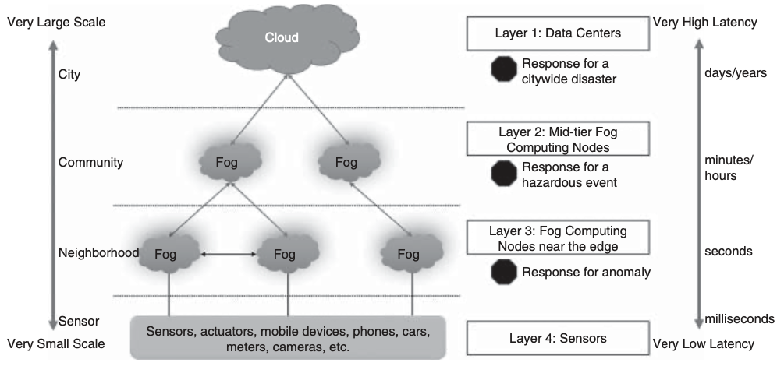
Machine Learning in Fog Computing
Machine Learning in Fog Computing Security
Hierarchical Fog Architecture for Security

Slide 78
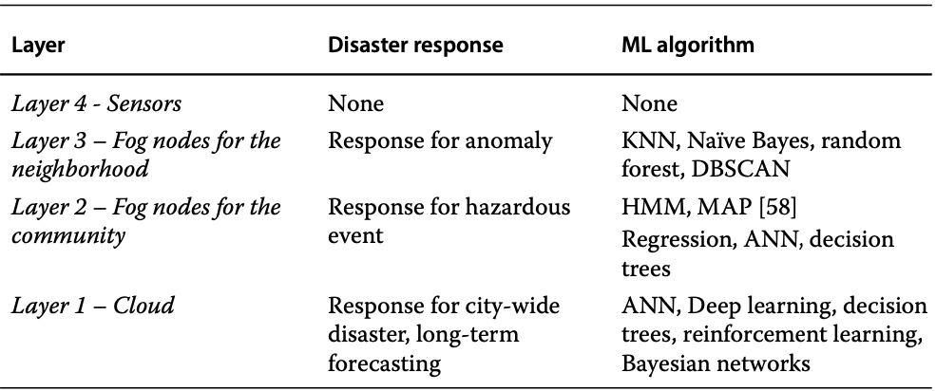
Machine Learning in Fog Computing
Machine Learning in Fog Computing Security
Machine-learning algorithms at different fog layers

Slide 79
Data Analytics in Fog Computing
Fog computing is a virtualized platform that provides computation, storage, and networking services between end devices and traditional cloud data centers, typically located at the edge of the network.
Key Characteristics:
Low latency
Mobility support
Real-time interactions
Online analytics
Interplay with the cloud

Slide 80
Data Analytics in Fog Computing
Challenges of Cloud-Only Data Processing
Transferring all IoT-generated data to the cloud for processing or storage is expensive, technically impractical, and often unnecessary.
Latency Issues
Cloud-based analytics works well for historical data but fails for real-time, high-data-rate applications.
Cost and Storage
Fog computing reduces communication time, costs, and the need for massive cloud storage by preprocessing data locally.
Network Infrastructure Stress

Slide 81
Data Analytics in Fog Computing
Fog Computing's Role in IoT
Data Preprocessing
Hybrid Approach
Applications
Filters, processes, and summarizes data before sending it to the cloud.
Combines fog localization (low latency, context-aware) with cloud globalization (centralized storage, historical analysis).
Ideal for IoT use cases requiring real-time analytics, such as smart cities, healthcare, and intelligent transportation systems.

Slide 82
Data Analytics in Fog Computing
Fog Analytics
Localized Processing: Performs preliminary analysis near the data source to reduce the volume of data sent to the cloud.
Example: Google Photos uses machine learning on mobile devices (via Movidius chips) for real-time photo classification.
Streaming Analytics: Handles continuous incoming data streams for real-time decision-making.
Standardization Needs: Requires standardized device/data interfaces, seamless cloud integration, and flexible network architectures.
Machine Learning: Enables performance improvements over time for IoT applications.
Data Visualization: Provides insights closer to the edge for faster decision-making.

Slide 83
Data Analytics in Fog Computing
Fog Engines
Fog-engines (FEs) are customizable, agile platforms integrated into IoT devices for on-premise, real-time data analytics.
Transparently managed by end users, FEs provide local peer-to-peer networks beneath the cloud.
Capabilities:
On-premise and real-time analytics.
Communication between IoT devices and the cloud.
Offloading data to the cloud for global analytics.

Slide 84
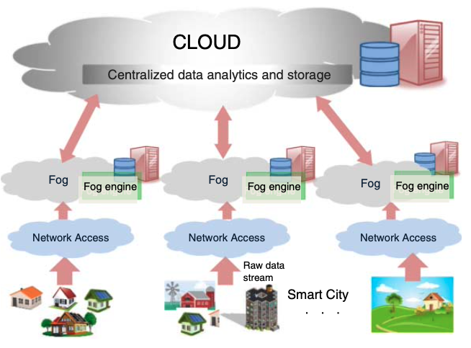
Data Analytics in Fog Computing
Fog Engines

Slide 85
Data Analytics in Fog Computing
Fog Engines - Key Features
Modular APIs: Provide consistent functionality across fog-engines and cloud platforms.
Hardware Diversity: Utilizes multi-core processors, FPGAs, or GPUs for fine-grained processing.
Fault Tolerance: Tasks can be transferred to nearby fog-engines in case of failure.
Energy Efficiency: Battery-powered FEs are suitable for IoT applications with limited power access.

Slide 86
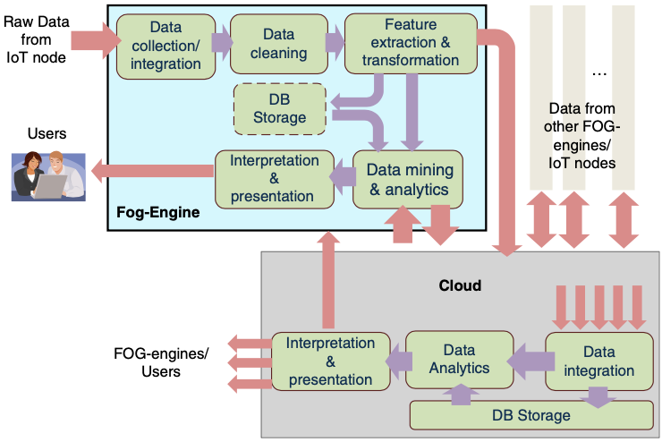
Data Analytics in Fog Computing
Data analytics using a fog-engine before offloading to the cloud

Slide 87
Data Analytics in Fog Computing
Fog Engines Vs Cloud Computing
Feature | Fog Engine | Cloud Computing
Proximity to Data Source | Near the edge (low latency) | Centralized (higher latency)
Processing Power | Limited | High
Storage Capacity | Limited | Massive
Resource Control | User-configurable | Out of user’s control
Energy Efficiency | Suitable for battery-powered IoT devices | Constant power supply
Cost Model | Owned by the user | Pay-as-you-go

Slide 88
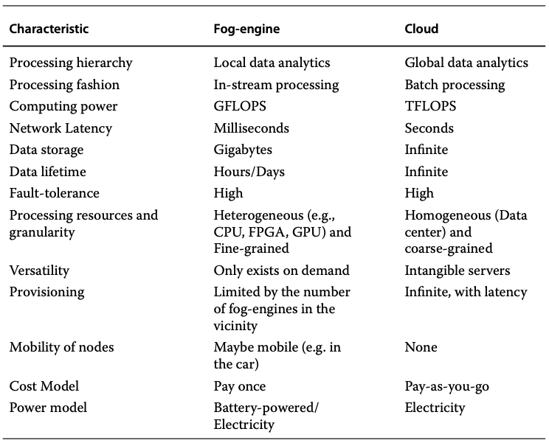
Data Analytics in Fog Computing
Fog Engines Vs Cloud Computing

Slide 89
Data Analytics in Fog Computing
Data Analytics Using Fog-Engines
Workflow:
Local Analysis: In-stream data is analyzed in real-time by the fog-engine near the data source.
Data Offloading: Filtered, preprocessed data is transmitted to the cloud for offline, global analytics.
Example: In a smart grid, fog-engines help users optimize energy usage locally, while cloud analytics determines policies for an entire town.

Slide 90
Data Analytics in Fog Computing
Advantages:
Reduced Data Volume: Preprocessing minimizes the amount of data sent to the cloud.
Real-Time vs. Offline Analytics: Fog-engines handle real-time analytics; the cloud performs historical analysis.
Dynamic Fog Networks: Multiple fog-engines in proximity dynamically form a local fog network for collaborative processing.

Slide 91
Data Analytics in Fog Computing
Challenges:
Architecture Design: Developing scalable, hierarchical fog architectures.
Frameworks and Standards: Standardizing device/data interfaces and integrating fog with the cloud.
Resource Management: Efficient provisioning and scheduling of storage and networking resources.
Security and Privacy: Addressing vulnerabilities in distributed fog environments.

